Slide 1
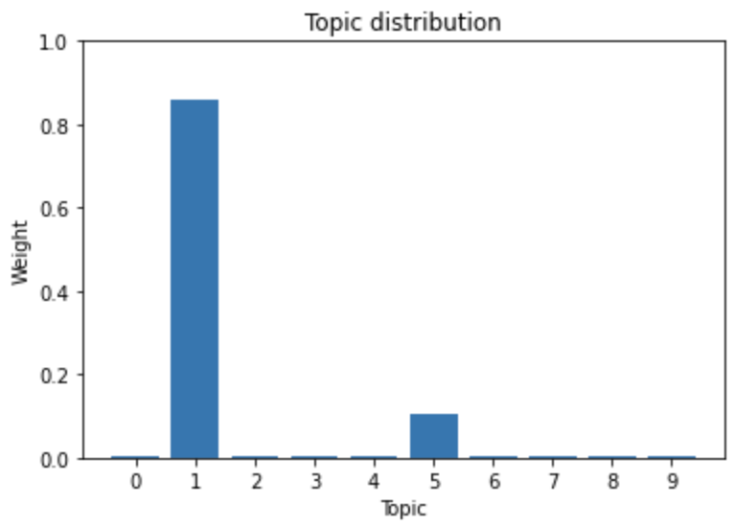
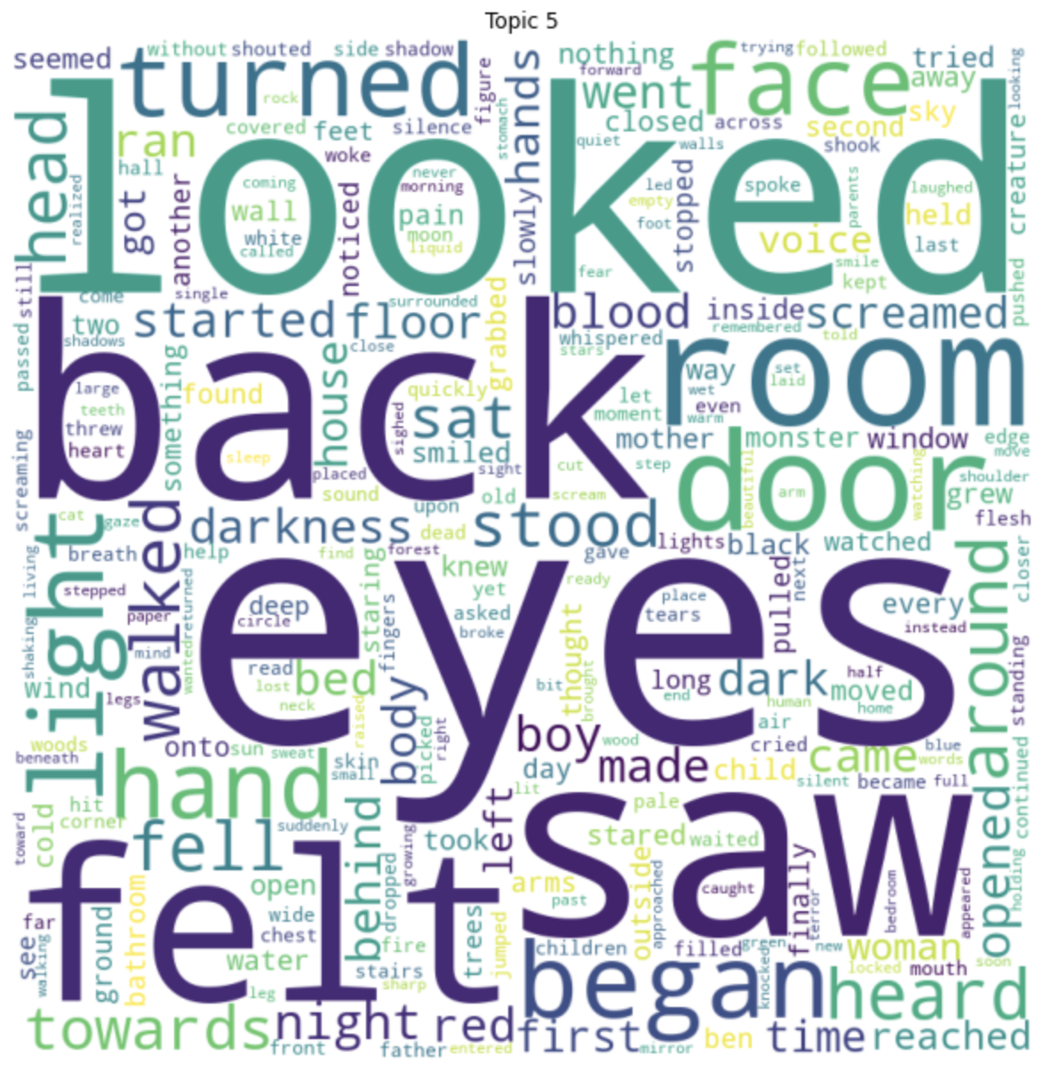

Slide 2
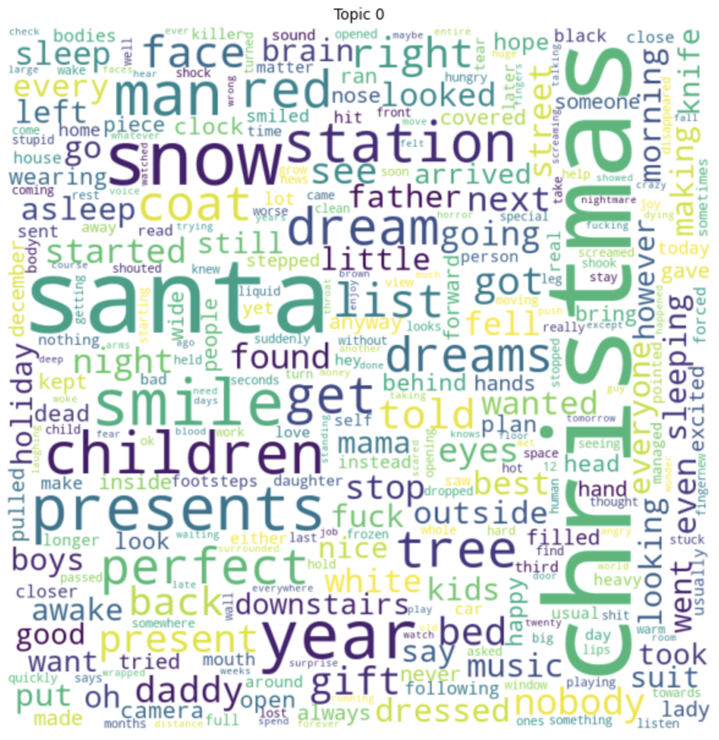
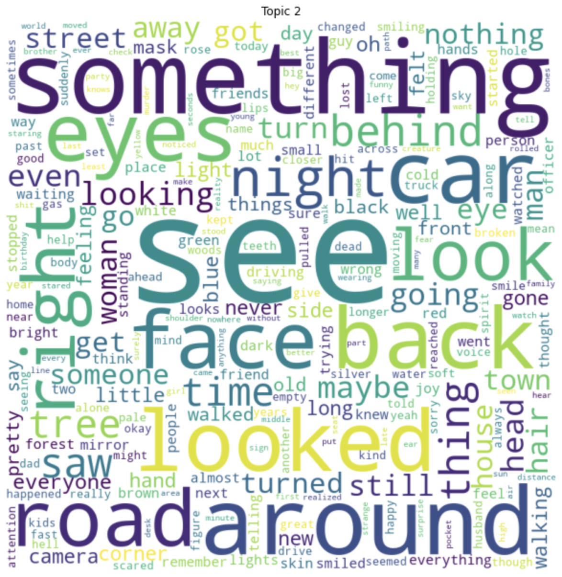
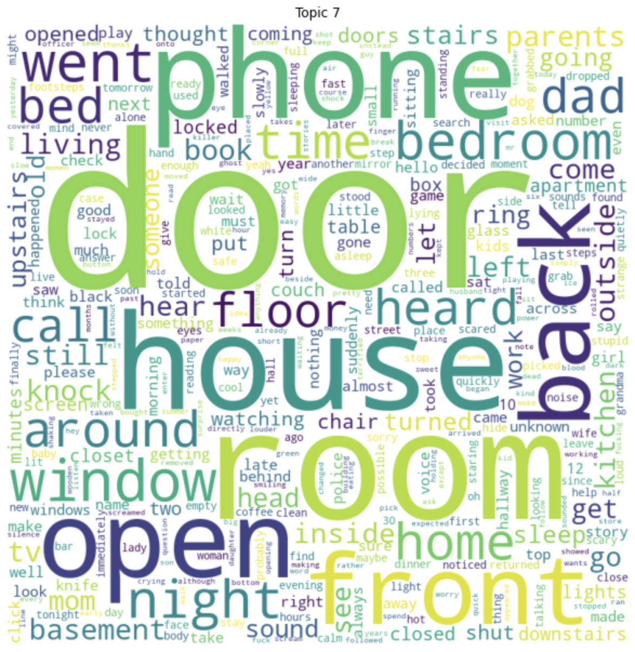

Slide 3
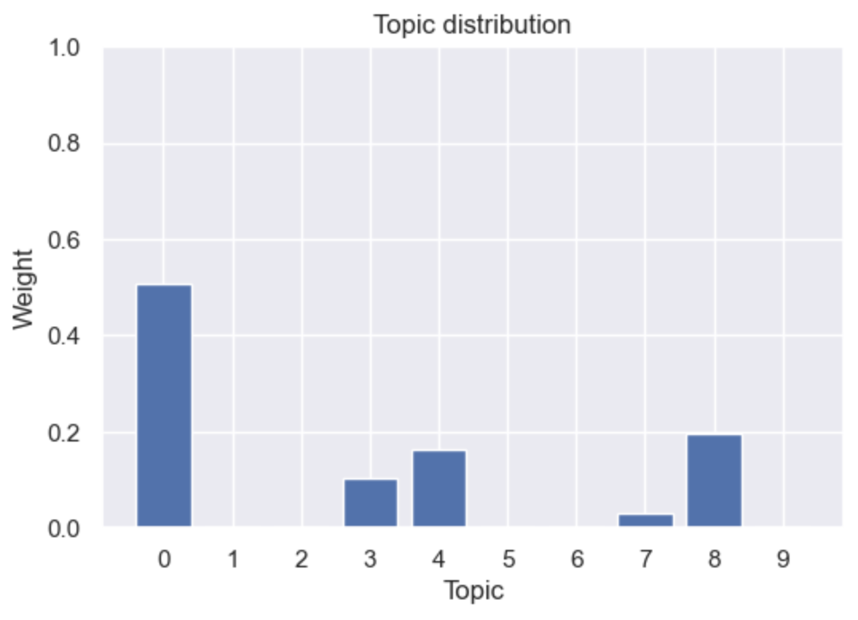
Christmas is my favourite time of the year! I've been a really good boy this year, helping Mummy and Daddy out with chores around the house and doing all my homework. I haven't missed a day of school this year!
Mummy and Daddy say they can't grow money on trees so we don't have much but I still love everything they get me. Mummy and Daddy say that Santa has a magic key that he opens the front door with to drop off the presents. I've tried to keep my eyes open and catch him but they say he can see when you're awake, I usually fall asleep after too long anyway. All I know is Santa must be a very good man, making presents for all the children of the world. Mummy and Daddy say Santa has elves that work for him to make all the toys, the elves must work very hard to make all those presents in time.
On Christmas Day, Mummy and Daddy put me to bed and I was so excited to see Santa. My eyes felt so heavy and I fell asleep with ease.
I woke up suddenly. I was being picked up, it was dark so I couldn't see what was happening - 'I think it's Santa' I thought to myself. I fell back asleep in his arms, knowing he was taking me to see the elves.
It's been 3 years since I've been here. Santa's Grotto isn't a happy place, the man who forces us to work says Santa won't be happy if we get behind. I want to know why Santa has taken me? I want to know why my parents would let a man into our house who does this to children? I don't know whether I'll ever get out of here. Until then I'm one of Santa's little helpers.
Merry Christmas.

Slide 4
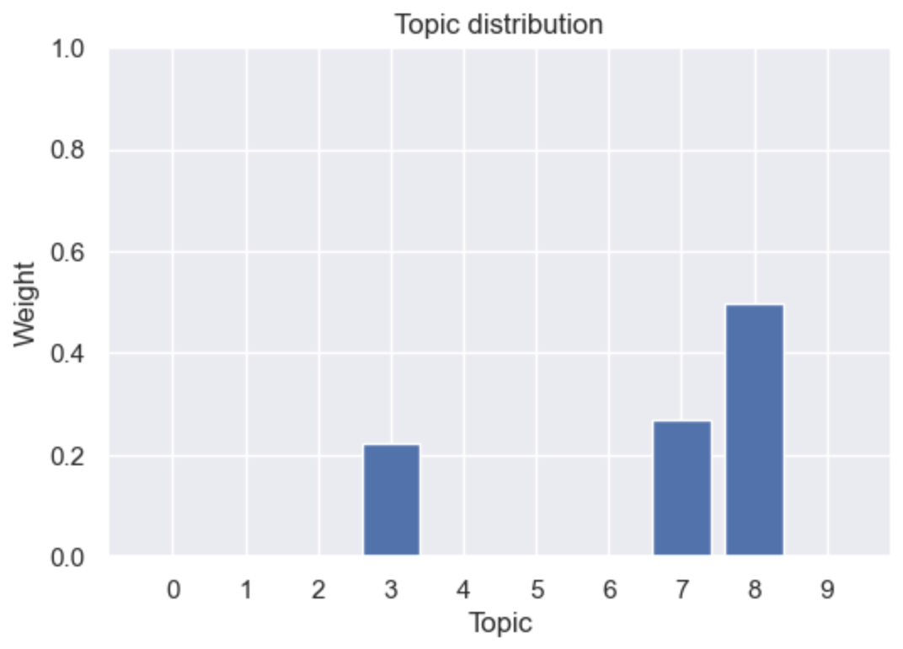
I loved my grandpa as much as you can love another for what little time I knew him. He died when I was 2 years old. I love when mommy tucks me in at night telling me stories about how much he loved me.
Mom said "he really loved you so much" as she sighed. He loved to go bounce you on his knee. He just loves you so much that he wants to keep in touch mom said.
That's why he still visits me, mommy? I asked. Yes, she said as she kissed me good night and left the room. She turned the lights out and closed the door. I knew grandpa nite nite would be there like always.
Mommy was always right I thought as I twisted my 5-year-old frame to one side. He'll be here soon though he scares me at times. Like when he gives me my goodnight kiss a long tongue comes out his mouth.
But I really hate when he climbs up the walls like a spider and twists his head 180 degrees and stares directly down at me. Grinning a big toothy grin that reached cheek to cheek.
Licking his lips and making growling sounds so I look at him. I gotta go to bed now I can hear the closet door opening. Hopefully just maybe he will think I'm asleep. Good night grandpa nite nite.

Slide 5
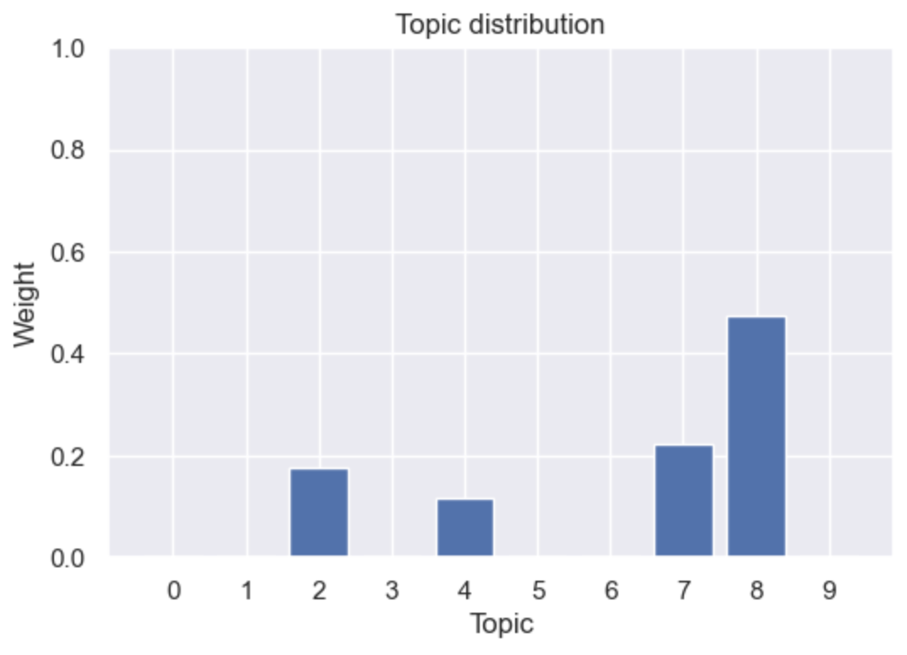
In the apartment complex where I now live in, there's a story about a girl who lived in one of the buildings. She lived on the 7th floor and used to go home late, because she was working on her thesis and her school was a bit far from her place. The story goes that everytime she would take the elevator, it would stall on the fourth floor. The slide doors wouldn't open or anything, but there'd be this feeling of pressure on the elevator, as if someone were to step in and join her.
Do you know the feeling of having someone stand next to you and stare at you, even though you couldn't see them? Apparently, this would happen to her each time. In fact, it got so bad that one particular night, she asked her mother if she could wait for her in the lobby and accompany her upstairs. Her mom, of course, agreed.
The girl arrived home later than usual that night, say around, 3am. Thankfully, her mother was at the lobby, waiting for her like she promised. They entered the elevator together, and when the elevator paused on the fourth floor, the girl looked at her mother and said, "See what I mean? It always happens!"
The older woman, in an effort to comfort her daughter, wrapped an arm around her shoulder and leaned in, right before whispering, "Do I really look like your mother?"

